Slide 1
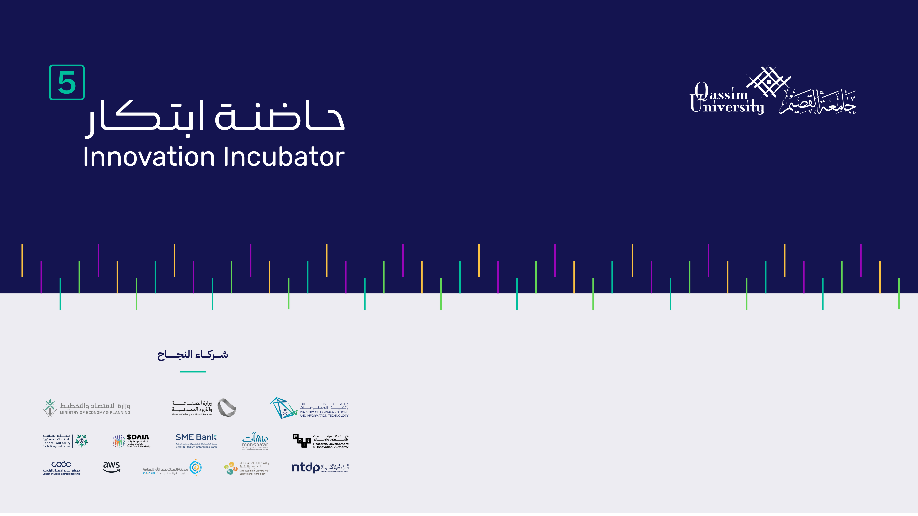
A-Grid
SmartGrid Monitoring & Fault Detection using AI and PoA² Blockchain

Slide 2
المشكلة:
Global utilities lose $96B annually to Non-Technical Loss (NTL) and undetected faults
🔒
Data Integrity
⏱️
Response Latency
90%
Minutes
meter data can be manipulated
vs millisecond damage window
📋
Trusted Records
📉
Scalability
Zero
Fails
tamper-proof audit systems
at real-time processing scale

Slide 3
الحل:
A hybrid AI-Blockchain smart grid monitoring system built on three tightly coupled layers:
🧠
Edge Intelligence Layer
— Core Innovation
Layer 1
Isolation Forest + LSTM models detect voltage anomalies, energy theft patterns, and equipment faults in milliseconds — directly at the edge device, before data leaves the source.
🛡️
Data Trust Layer
— TEE-Ready
Layer 2
Software-based validation verifies sensor data integrity before blockchain submission. TEE-ready design allows optional hardware-level trust anchoring without day-one hardware requirements.
⛓️
Blockchain Trust Layer
— Purechain PoA²
Layer 3
Purechain's PoA² consensus creates an immutable record of verified data and fault events — enabling full forensic audit trails and tamper-proof accountability with <2-3s finality.

Slide 4
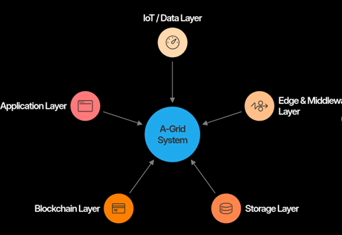
القيمة التنافسية:
IoT / Data Layer
Smart meters (or simulated devices) measuring energy production, consumption, voltage, and current.
Edge & Middleware Layer
Built with Node.js / Python — performs data validation, AI-based fault detection, and data filtering.
Storage Layer
IPFS (off-chain) stores full sensor data; blockchain (on-chain) stores hash + metadata. Achieves >70% storage reduction.
Blockchain Layer
Purechain PoA² handles transaction validation, consensus, and immutable recording with <2-3s finality.
Application Layer
Dashboard displaying energy usage, fault alerts, and historical data.

Slide 5
حجم السوق:
$103.4B
↑ 17.2% CAGR
from $33.9B in 2023
Global Smart Grid Market by 2030
Grid Monitoring & Faults
$12.1B
AI in Energy
$7.9B
Blockchain in Energy
$6.2B
Energy Theft Detection
$4.8B
🏙 GCC & MENA
🌍 Global Drivers
Saudi Vision 2030 investments exceed $20B — A-Grid aligns directly with NEOM and SEC grid modernization.
Energy digitalization mandates, renewable integration, and grid modernization programs worldwide.

Slide 6
المنافسين:
A-Grid sits at the intersection of three markets — no single competitor covers all three layers simultaneously.
Competitor | Edge AI | Blockchain Trust | Real-Time Faults | Data Validation
ABB / Siemens / Schneider | ✕ | ✕ | ∼ | ✕
Power Ledger / Grid+ / WePower | ✕ | ✓ | ✕ | ✕
Utilidata / AutoGrid / Awesense | ✓ | ✕ | ✓ | ∼
A-Grid (Our Solution) | ✓ | ✓ | ✓ | ✓
✓ Yes ✕ No ∼ Partial

Slide 7
الخطة المستقبلية:
Year 1
Year 2–3
Year 4+
Prototype to Pilot
Commercialization
Scale & Research
Edge AI + blockchain integration
Launch Forensic-as-a-Service (FaaS)
Federated learning across grid nodes
Pilot with KSA/GCC utility partner
Energy Trust Score for prosumers
Hardware TEE integration
Publish benchmarks: latency, TPS, NTL accuracy
3+ MENA utility deployments
IEEE & IEC standardization

Slide 8
الفريق:
AA
Ali Ahmad Bukar
AH
Alhassan Hashim
AA
AH
BACKEND & SYSTEMS ENGINEER
BLOCKCHAIN ARCHITECT
Core architecture, backend infrastructure, and AI-blockchain integration.
Designs PoA² consensus on Purechain — immutable fault recording and audit trails.
UF
Umar Faruk Ibrahim
MS
Md Shakil Hossain
AI & ML ENGINEER
DATA & VALIDATION ENGINEER
Trains Isolation Forest + LSTM models for millisecond anomaly detection at the edge.
Data trust pipeline, TEE-ready design, and IPFS-blockchain hybrid storage (>70% reduction).

Slide 9


